Slide 1
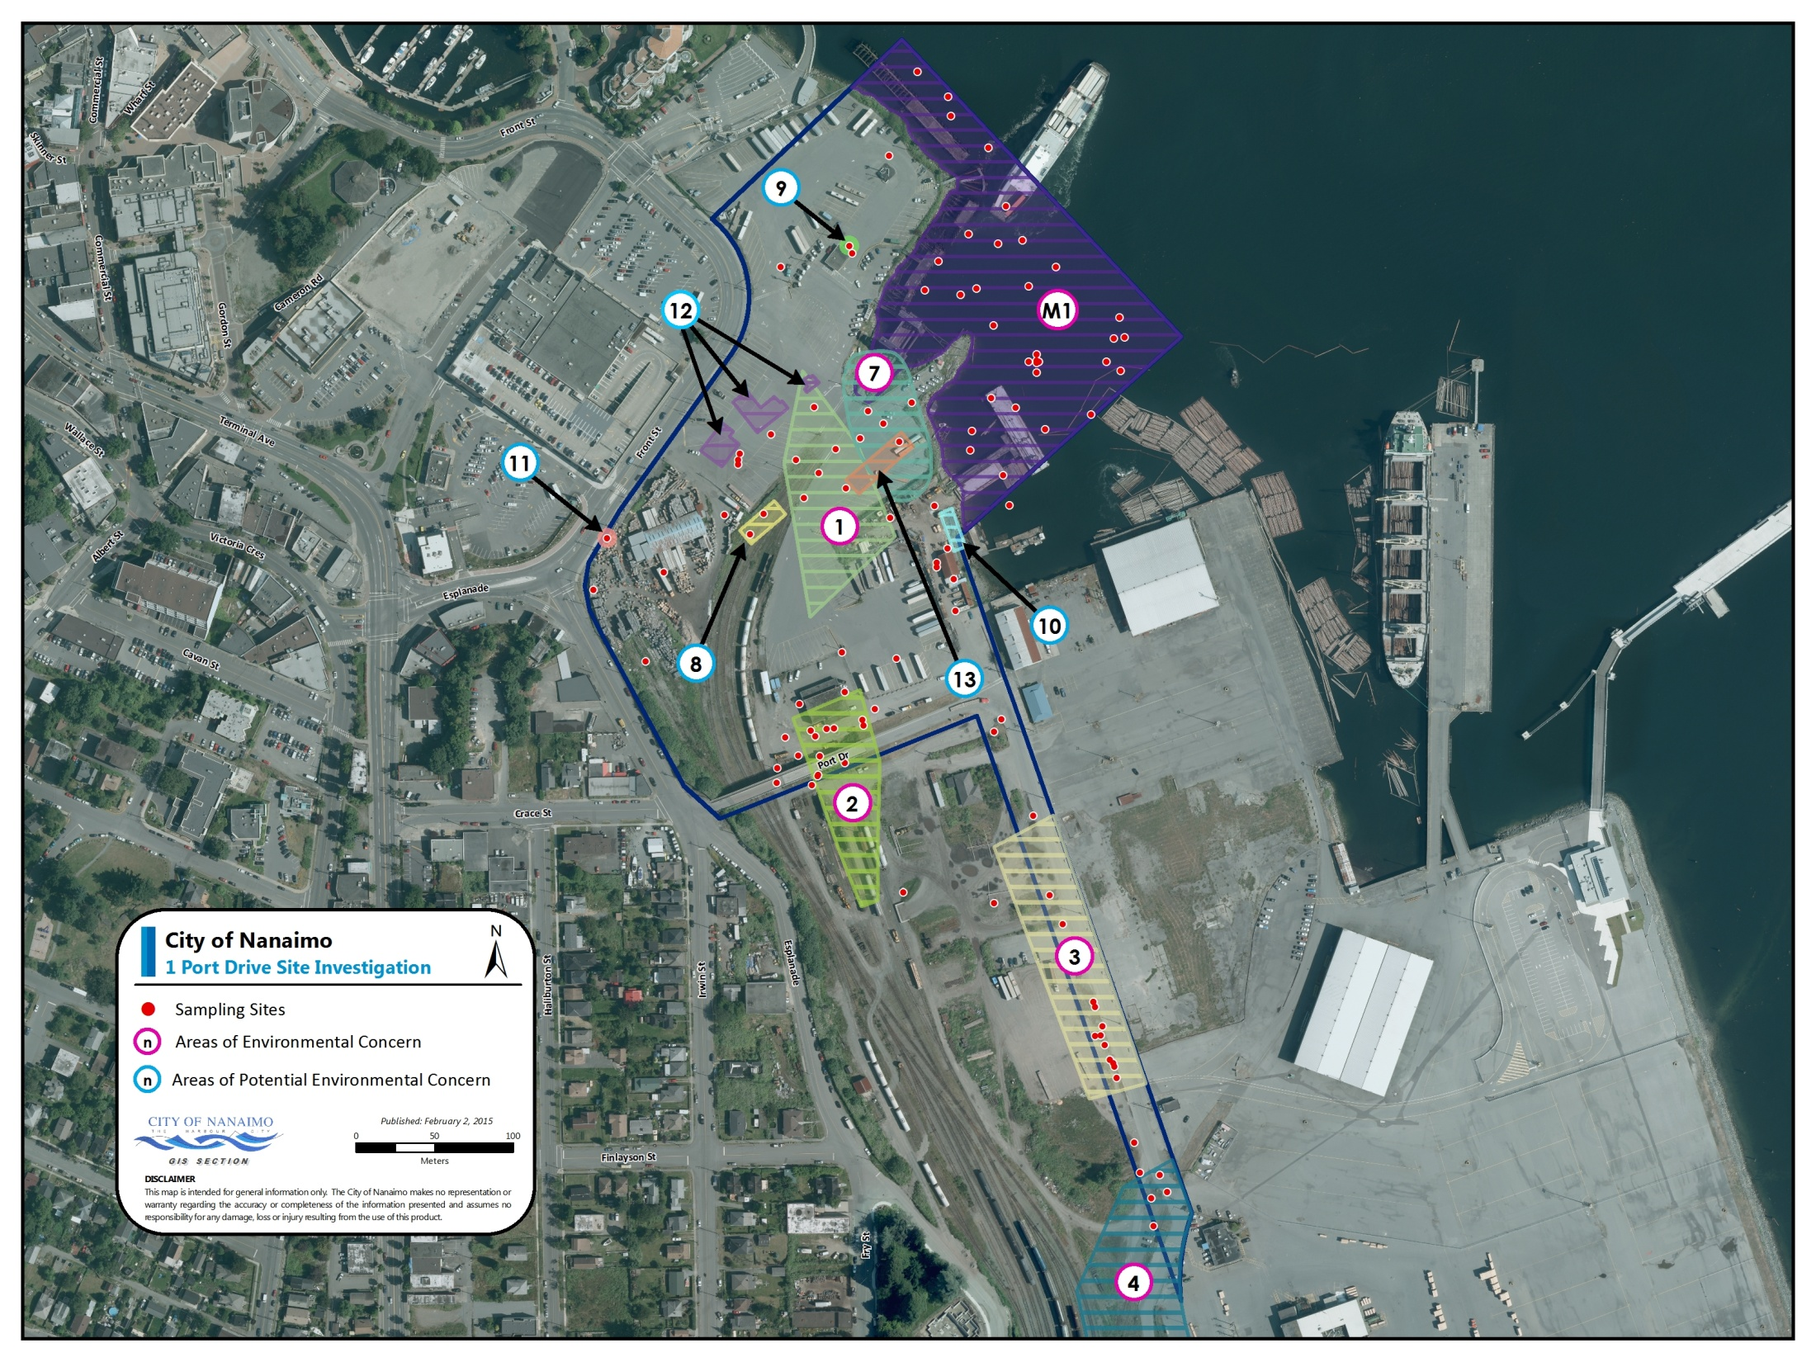

Detailed Site Investigation: Results Summary
1 Port Drive, Nanaimo BC
February 16, 2015

Slide 2
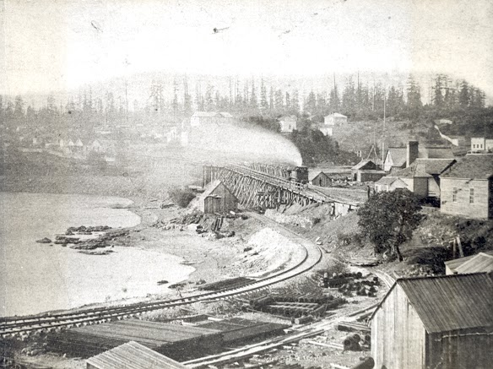
Agenda
Property background
Project scope
Stage 1 Preliminary Site Investigation (PSI) Results
Detailed Site Investigation (DSI) Results
2015 Workplan

Slide 3
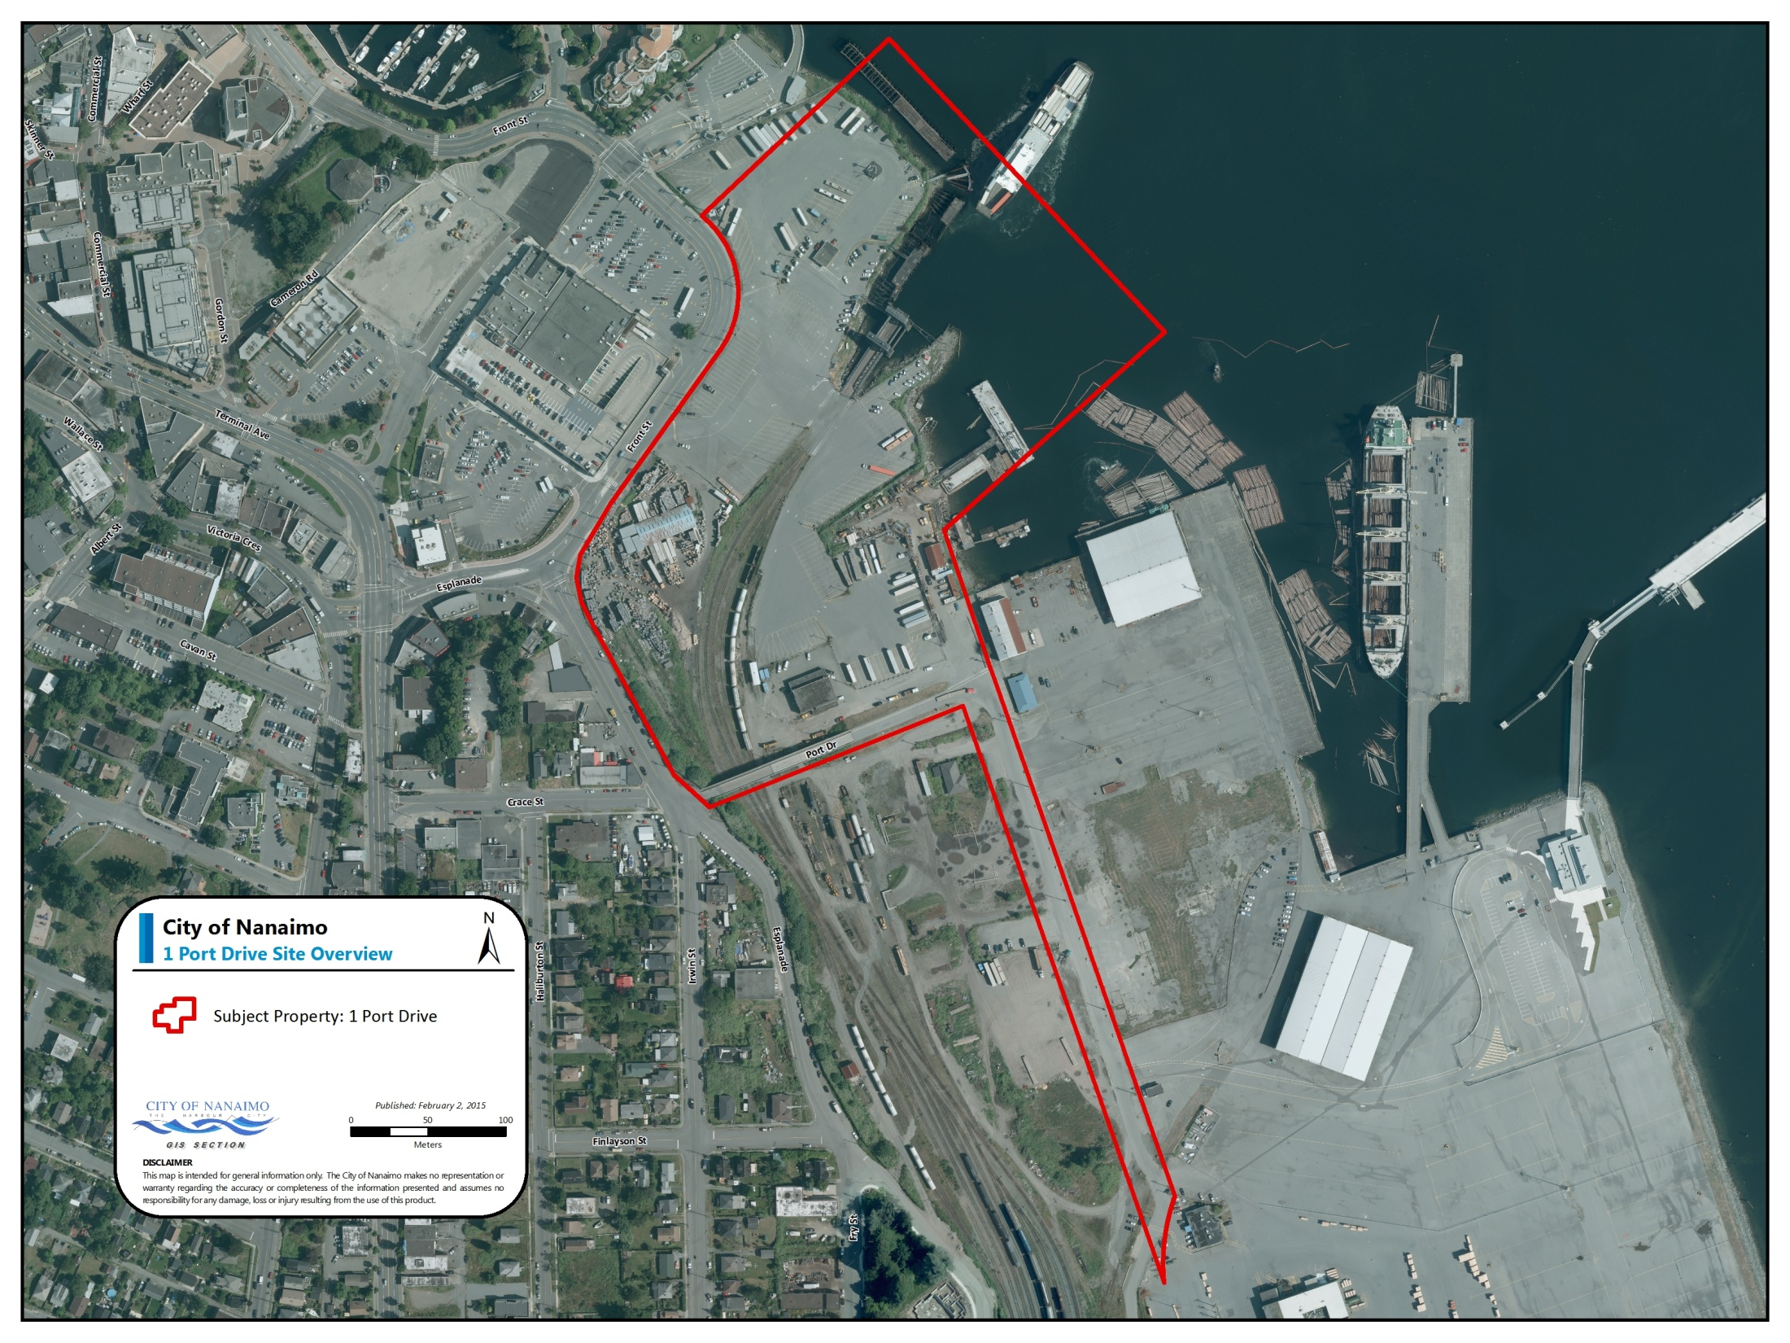
Purchased in 2013 by CoN
$3.4 million
10.8 ha (26.7 acres)

Slide 4
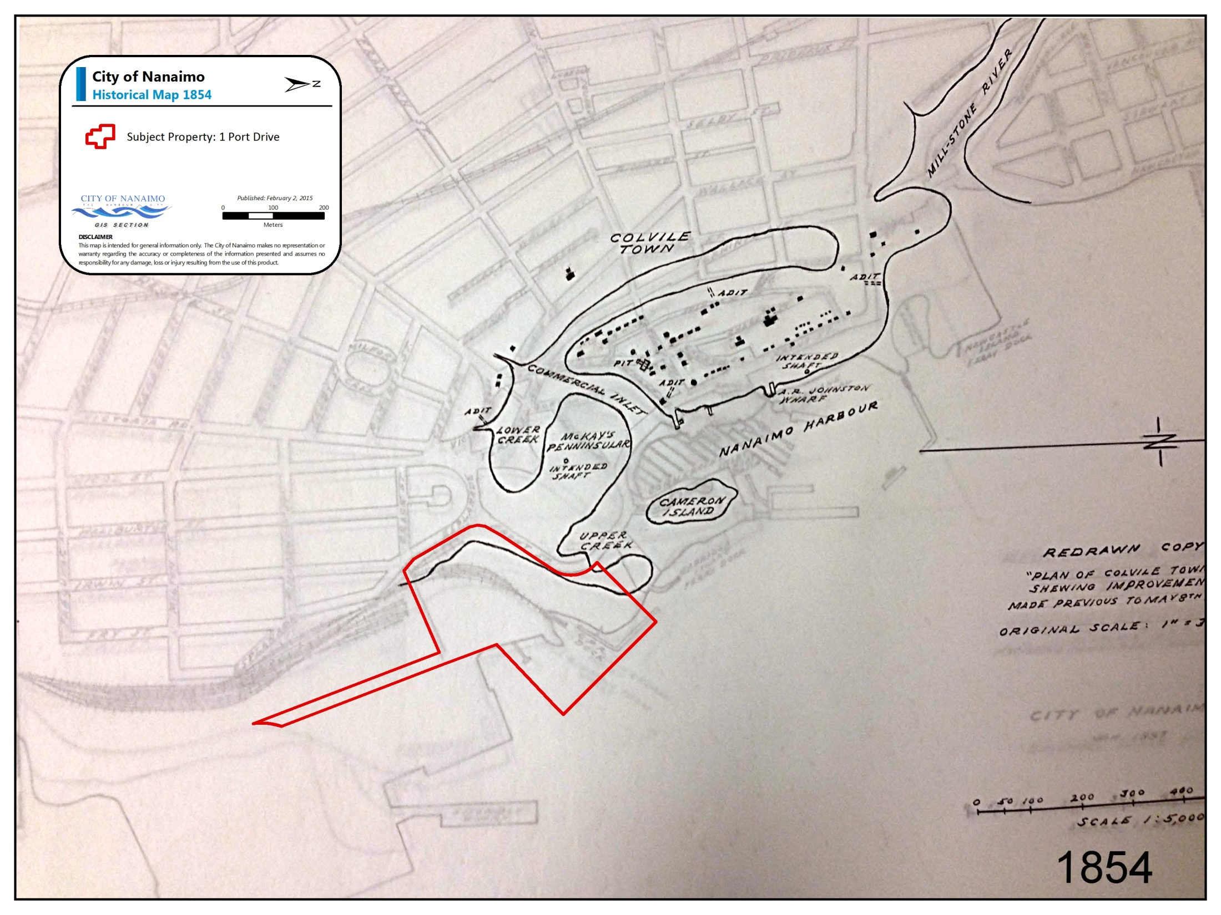

Slide 5
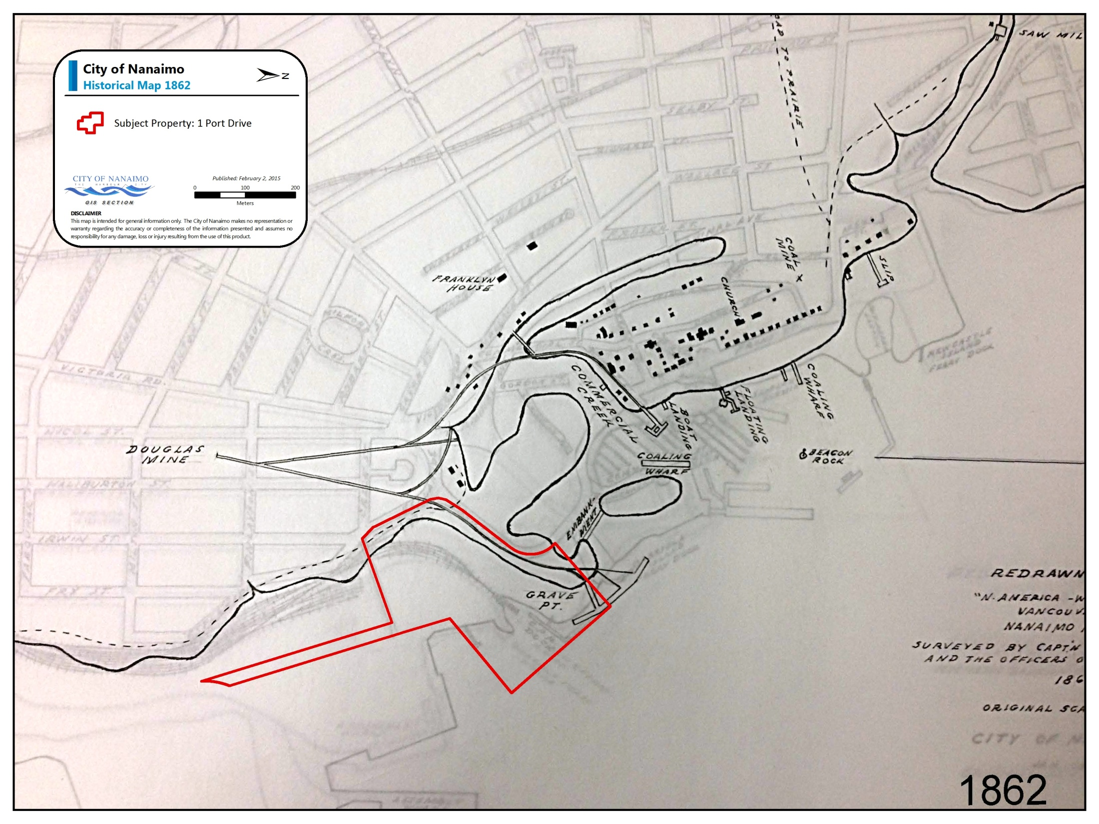

Slide 6
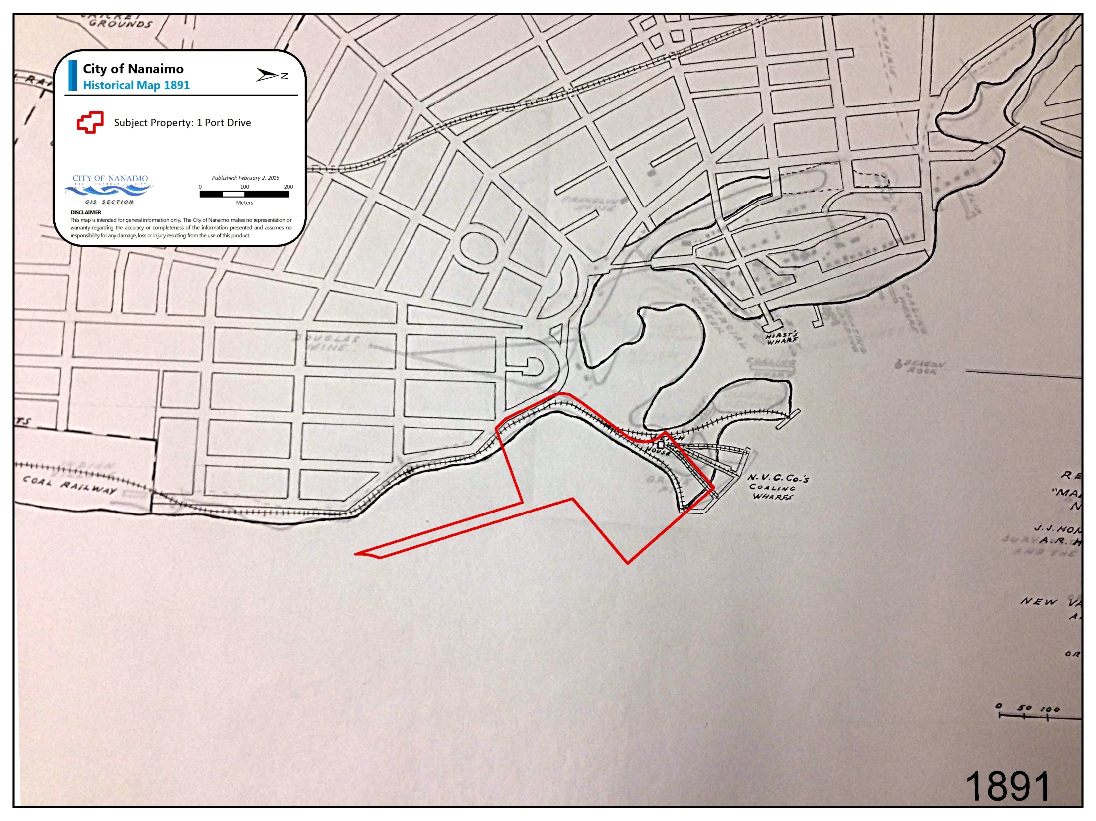

Slide 7
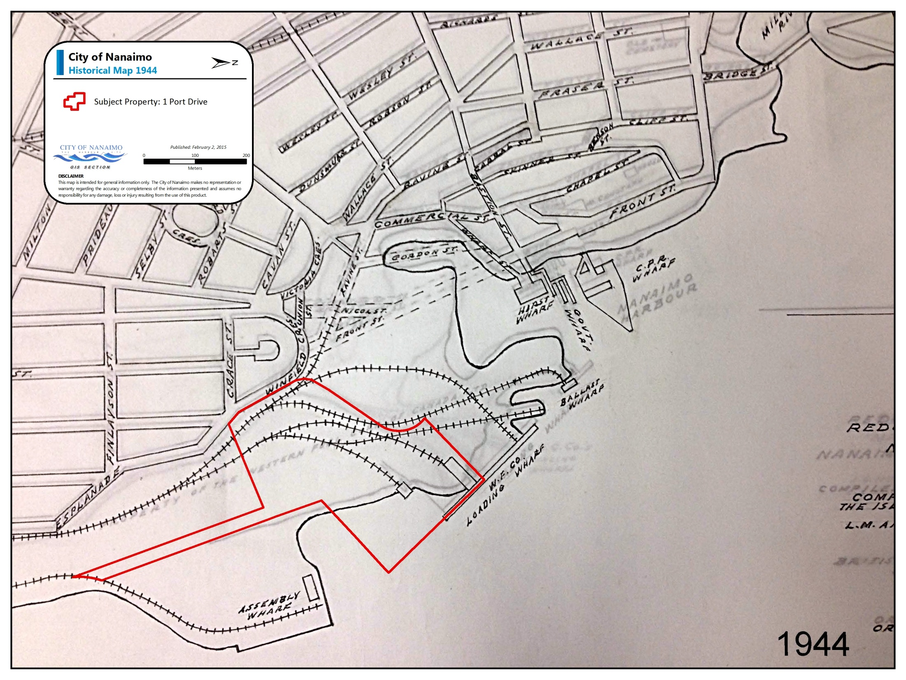

Slide 8
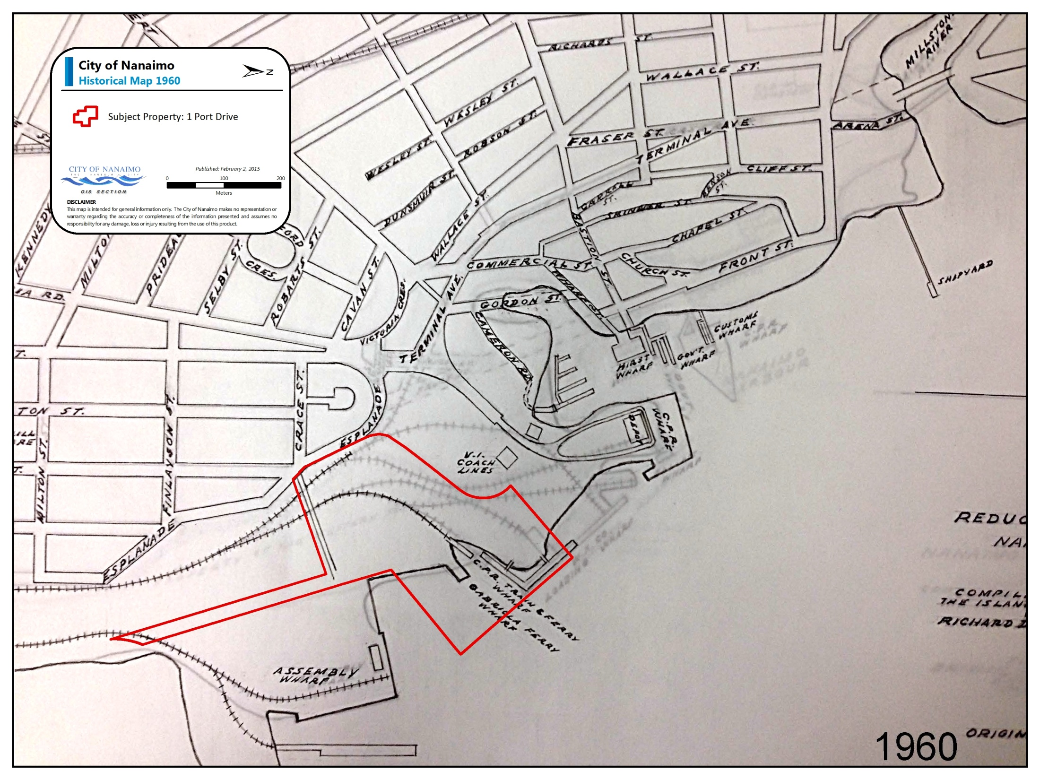

Slide 9
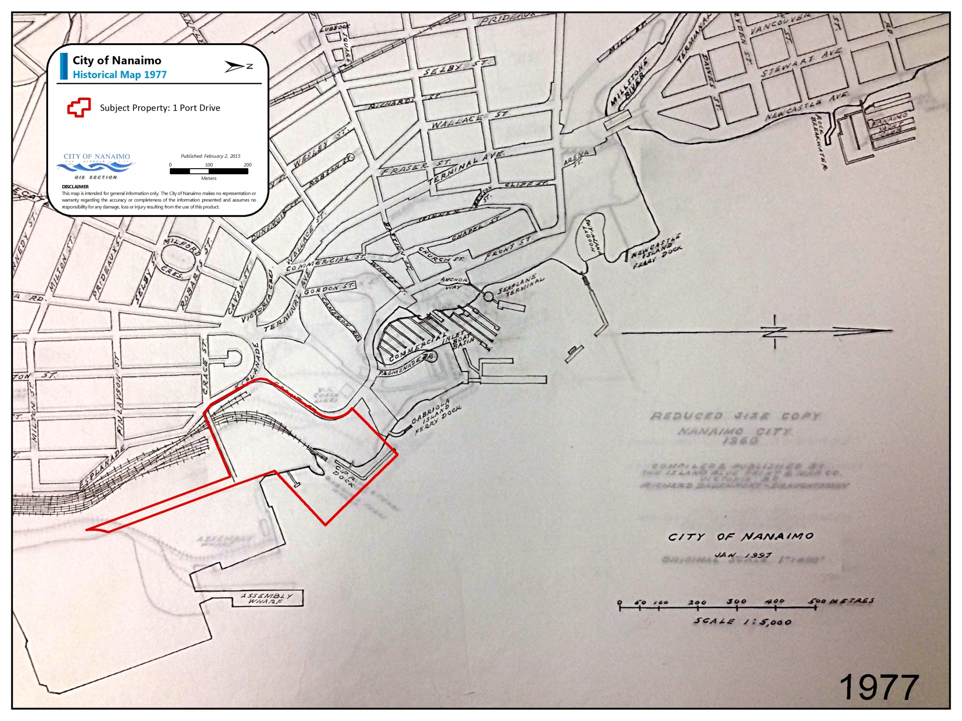

Slide 10
Project Scope
RFQ process in June 2014
Work awarded to Tetra Tech EBA
Project included an updated Stage 1 PSI Report and a DSI Report
Work program $230,000. FCM GMF provided $115,000 in grant funding

Slide 11
Stage 1 Report
Based on previous work by SNC-Lavalin in 2009 and historical site records
Identified the locations that have Areas of Concern (AEC) with known contamination
Identified the locations that have Areas of Potential Concern (APEC) that may have contamination

Slide 12
Insert slide with AEC’s & APECs

Slide 13
Detailed Site Investigation
Collected soil, groundwater, vapour and sediment samples from AECs and APECs to determine if there is contamination, and the extent of the contamination
Results compared against Commercial (CL) and Industrial (IL) standards from MoE Contaminated Site Regulations (CSR)
Screening Level Risk Assessment (SLRA) applied to results from upland area to assess if any risks are present based on land use

Slide 14
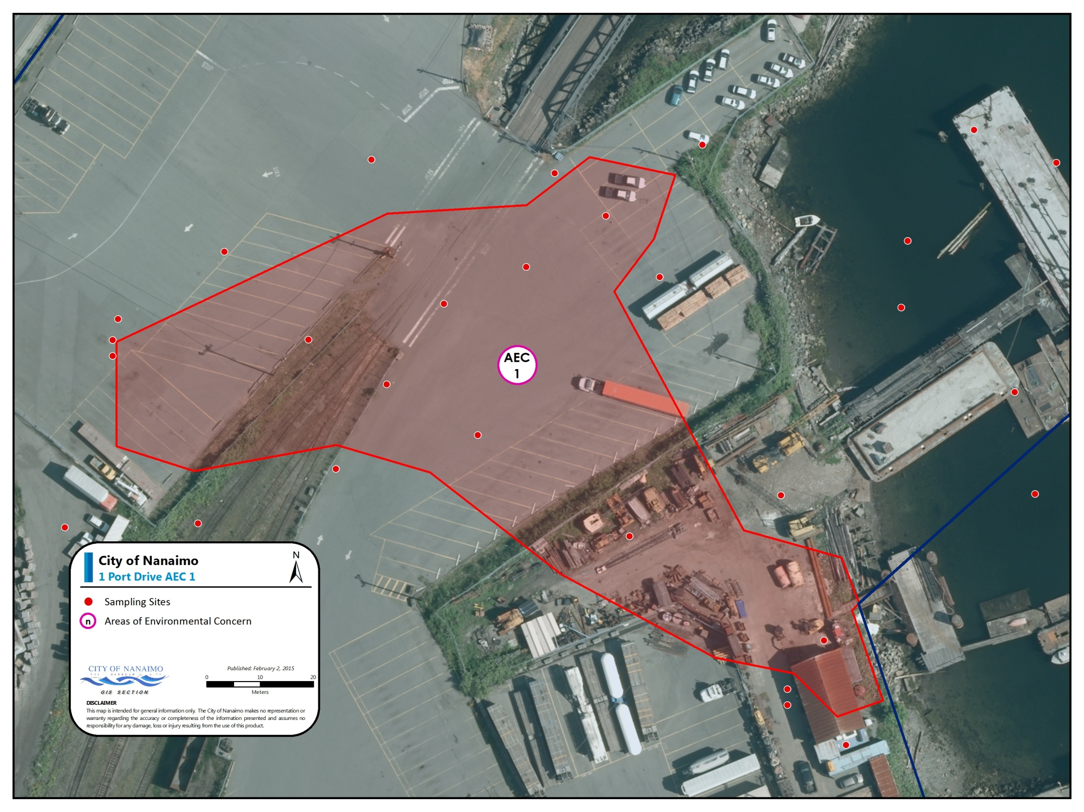
AEC 1
Soils | Chromium exceeds the CSR CL/IL Standard and Protocol 4 Background
Groundwater | Meets MoE Standards
Vapour | Meets MoE Standards
Extent | Area 1: 6,500m² Volume: 13,000m³
Comments | Soil impacts related to coal waste in fill soils
Development Considerations | Using a SLRA approach, these soils can remain in-situ with no need for remediation
Insert image

Slide 15
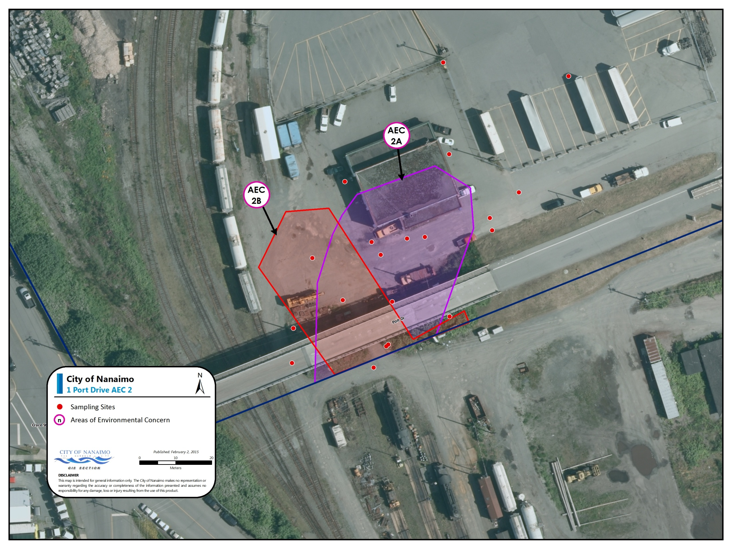
AEC 2
Soils | 2a: Light Extractable Petroleum Hydrocarbons and Heavy Extractable Petroleum Hydrocarbons exceed the CSR CL/IL Standard 2b: Chromium exceeds the CSR CL/IL Standards
Groundwater | Meets MoE Standards
Vapour | Meets MoE Standards
Extent | Area2a: 1,800m² Volume: 5,400m³ Area2b: 1,200m² Volume: 2,400m³
Comments | Hydrocarbons in the soil are not migrating
Development Considerations | Using a SLRA approach, these soils can remain in-situ with no need for remediation
Insert image

Slide 16
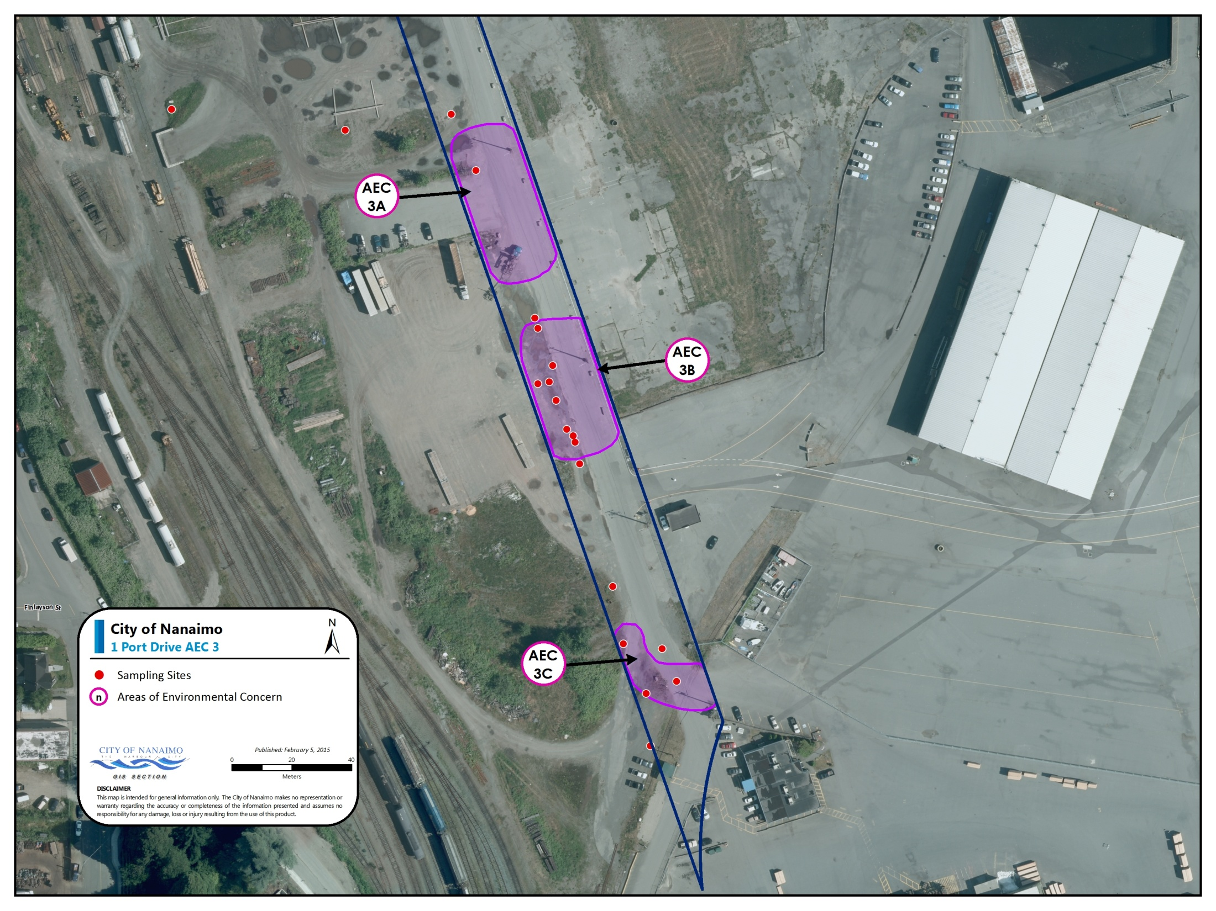
Soils | 3a: Chlorinated phenols exceed the CSR CL/IL Standard 3b: Chlorinated phenols and volatile petroleum hydrocarbon exceed the CSR CL/IL Standard 3c: Chlorinated phenols and arsenic exceed the CSR CL/IL Standard
Groundwater | Meets MoE Standards
Vapour | Meets MoE Standards
Extent | Area 3a: 1,800m² Area 3b: 1,000m² Area 3c: 1,00m² Volume: 9,100m³
Comments | Contamination is from former offsite sawmills
Development Considerations | Liability with original polluter and known to MoE. SLRA requires paving or 1 m capping with clean soil. All potential impacts to marine receptors cannot be fully assessed using SLRA part of larger plume. Future trenching work would require a ‘trench worker assessment’ prior to commencement of work

Slide 17
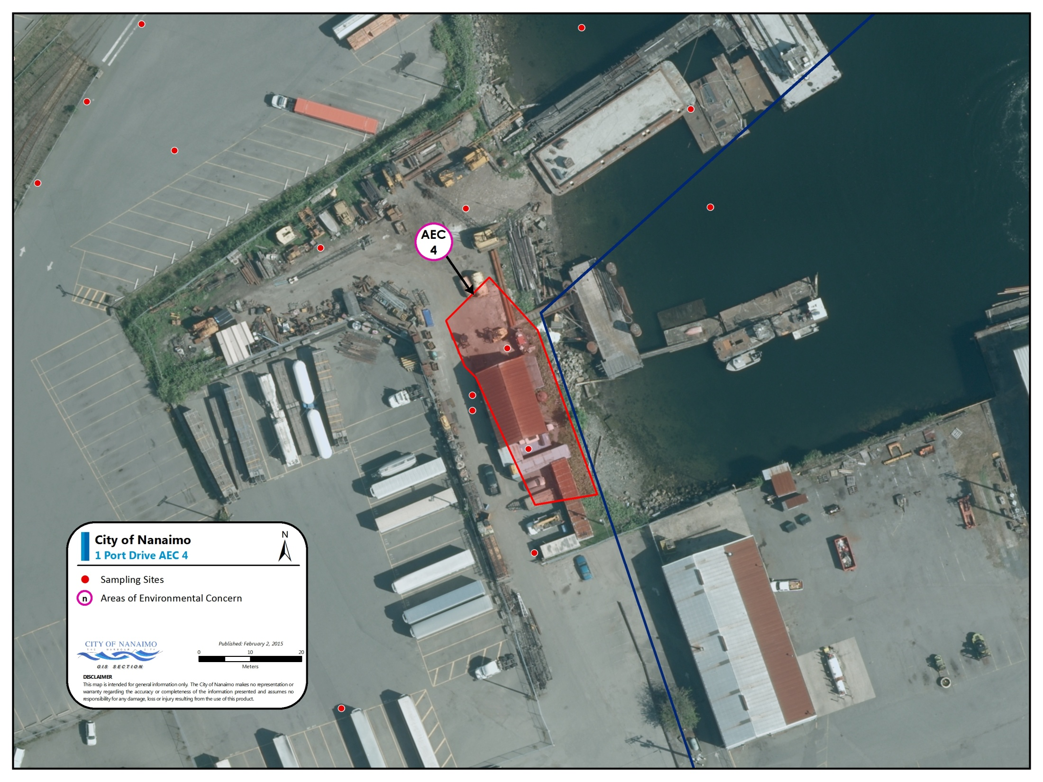
AEC 4
Insert image
Soils | Cadmium and zinc exceed the CSR CL/IL Standard
Groundwater | Meets MoE Standards
Vapour | Meets MoE Standards
Extent | Area 4: 600m² Volume: 1,320m³
Comments | Soil impacts related to coal waste in fill soils
Development Considerations | Using a SLRA approach, these soils can remain in-situ with no need for remediation but would require either 1m of clean fill or for all areas to be paved to meet SLRA

Slide 18
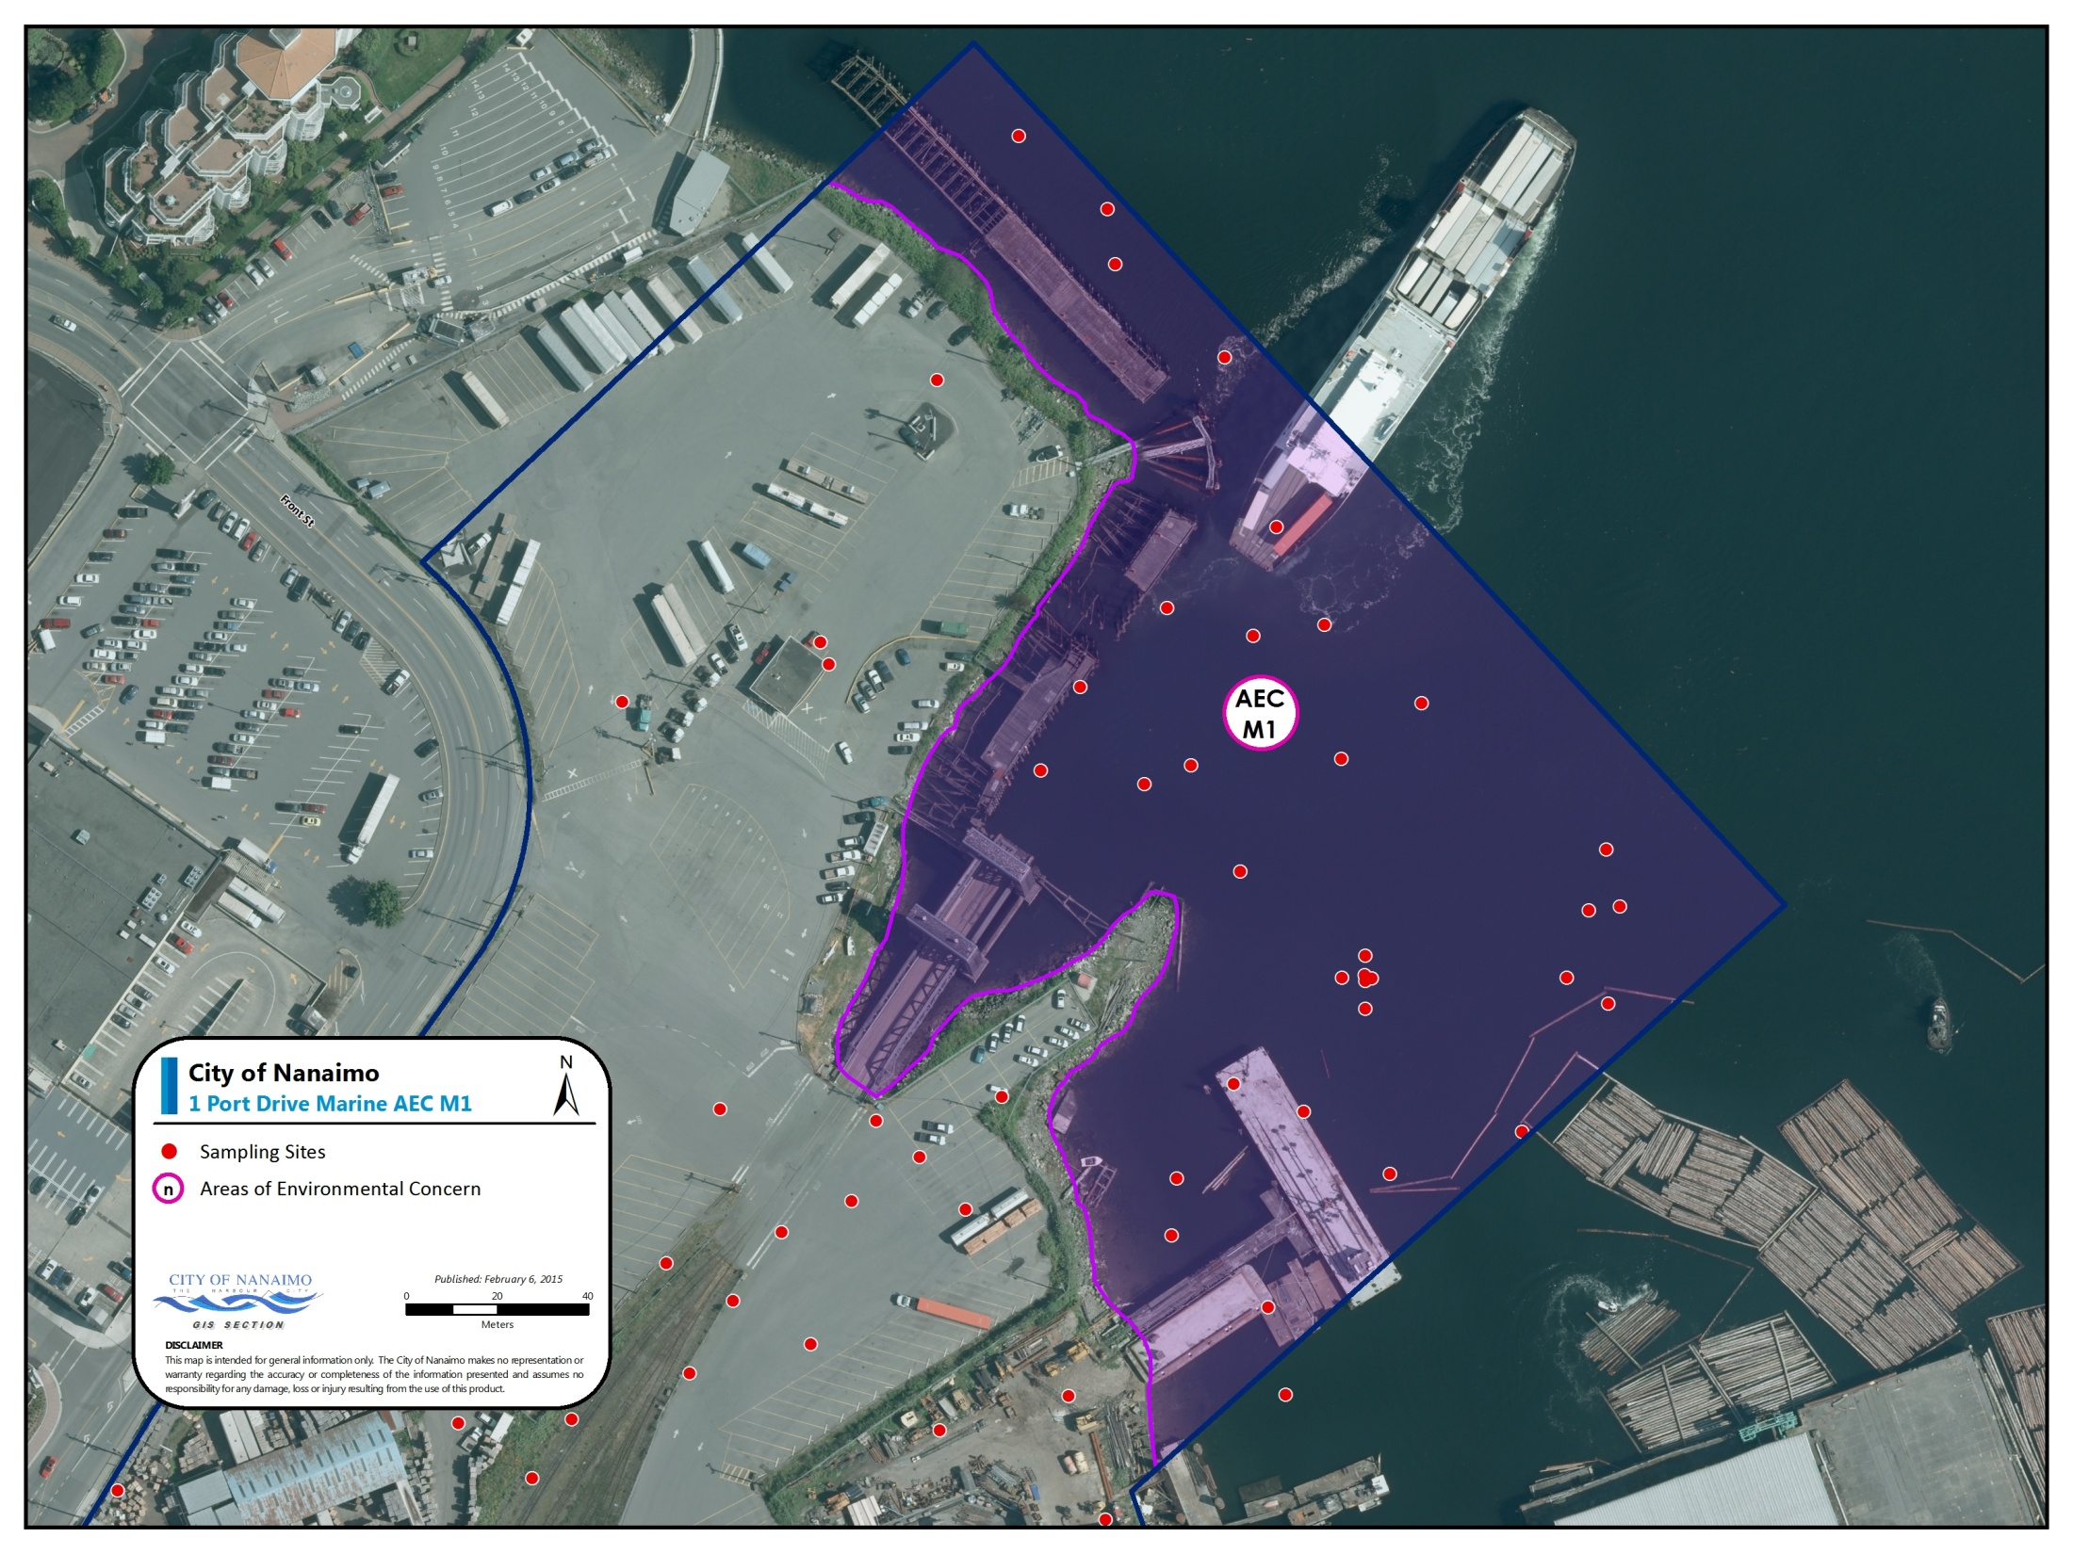
Marine AEC 1
Sediments | Polycyclic Aromatic Hydrocarbons exceed the CST Typical Sediment Standards
Groundwater | NA
Vapour | NA
Extent | Area M1: 980m² Volume: 1,470m³
Comments | Detailed Risk Assessment (DRA) required to assess sediment impacts and evaluate remediation options
Development Considerations | Future redevelopment of the parent property requires the DRA to be completed and possibly an approval in principle of a remediation plan from BC MoE in place, prior to redevelopment/subdivision of upland areas
Insert image

Slide 19
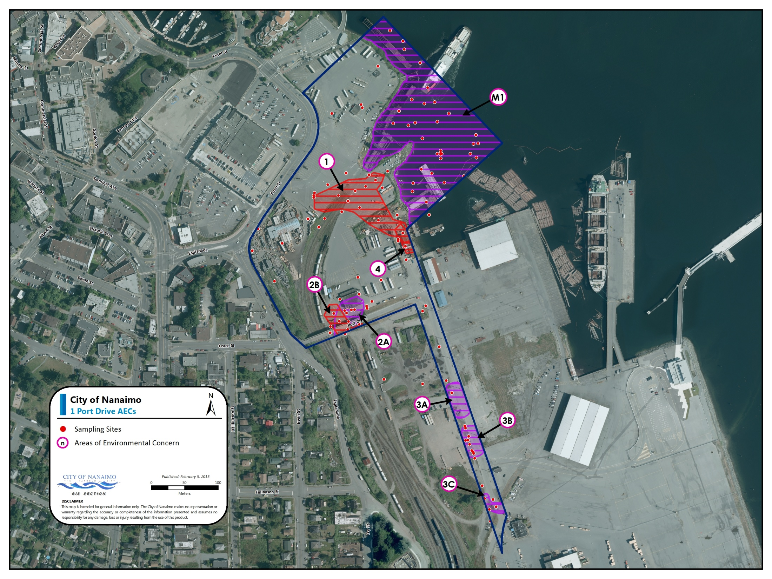

Slide 20

Implications
Insert map with Foy road over AECs

Slide 21
Conclusions
AECs are confined to 2.83 areas of upland and 6 .8 acre waterlot
Using a SLRA approach no clean up required for majority of property during future redevelopment
Majority of area adjacent to former sawmills not able to fully assess using a SLRA but will be under the future road
Require a Detailed Risk Assessment (DRA) and possibly an Agreement in Principle (AIP) from MOE on the waterlot to unlock future development & subdivision of the entire property

Slide 22
Next Steps
Seasonal sampling groundwater and further soil vapour assessment
Assess if ‘flow through’ status for a portion of AEC3 with highest soil impacts is feasbile
DRA for Marine AEC1
Evaluate potential remedial options for both upland and waterlot portion of property
Budgeted $210,000 in 2015 with $60k grant from FCM GMF
Prepare master plan for site (2015)
Prepare final remediation plan or plans to follow development and secure future development approvals and subdivision in 2016

