Slide 1
Welcome!
Housekeeping:
Zoom participation by phone:
  - Use *6 to mute and unmute
  - Use *9 to raise your hand
  Zoom participation by laptop or device:
  - Click or press the microphone icon to mute and unmute
  - Click the hand icon to raise your hand
Having issues connecting to Zoom?
  Send a message in the Zoom chat. Will will respond with technical support.
The meeting has not yet started.
Please follow the instructions below to set up:
Please mute yourself during presentations to reduce background noise.
If you have any questions or comments, feel free to share them through the group chat.

Slide 2


Manufactured Home Communities Electrical Capacity Assessment
Application Information Session
October 21, 2025

Slide 3


Introductions
From the City of Nanaimo:
David Stewart
Environmental Planner
Lisa Brinkman
Manager, Community Planning
From Dunsky and Prism:
Hannah MacDonald
Facilitator
Adam Franklin
Capacity Assessment Lead
Please share:
Your name and role
Community / Park name

Slide 4

Opening Remarks:
City of Nanaimo

Slide 5
Agenda
1 |  | About the Capacity Assessment Grant | 20 minutes
2 |  | Questions | 20 minutes
3 |  | Next Steps | 5 minutes

Slide 6

Project Background
This free guide is now available on the City of Nanaimo website:
Manufactured homes have higher energy costs compared to single-family homes and are more vulnerable to extreme temperature swings.
Heat pump (and other energy-efficient) upgrades can reduce energy costs and provide air conditioning. These upgrades also support City climate commitments.
The City and Regional District of Nanaimo produced a guide to support park owners and homeowners to complete energy-efficient upgrades.
City of Nanaimo home page → Your Government → Projects → Manufactured Home Community Energy Efficiency and Emission Reduction Strategy (2nd project down)
Notes:
Residents may choose to upgrade to a heat pump because of the following benefits:
Potential to lower heating bills
Lower upfront cost with government rebates
Provides air conditioning
Increased manufactured home value
Meets insurance requirements when replacing fuel oil

Slide 7
About this Capacity Assessment Grant
Creating the guide confirmed major challenges to heat pump installation, including:
many park owners have little information on current electrical capacity
and
there is uncertainty on how to collect accurate information.
Manufactured Home Community Capacity Assessment Grant
The City of Nanaimo is responding to these challenges by offering a new grant that will provide
~3 parks / communities with
free electrical capacity assessment,
valued at $4,000 to $8,000.
Notes:
However, heat pumps installs are more complicated in these homes due to the ownership structure, electrical system, and design.

Slide 8
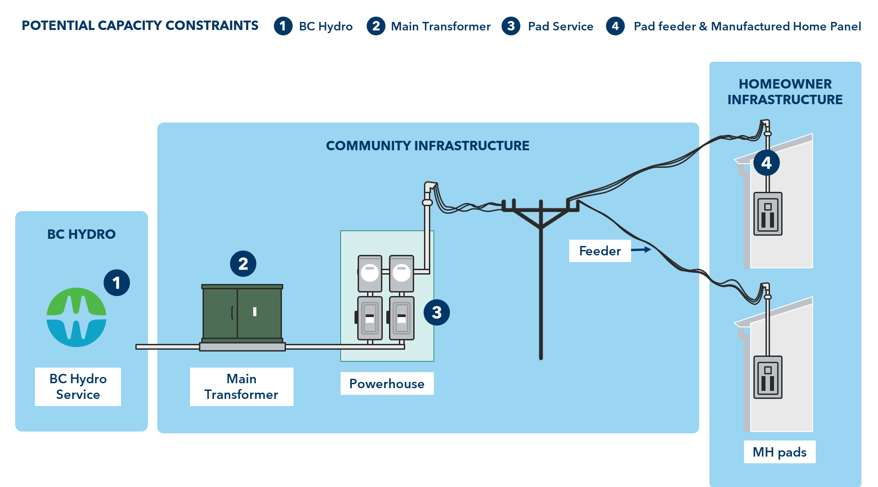
Why are Electrical Capacity Assessments needed?
Creating the guide confirmed major challenges to heat pump installation, including:
many park owners have little information on current electrical capacity
and
there is uncertainty on how to collect accurate information.
Note: capacity assessments are not always needed to support heat pumps.
Notes:
However, heat pumps installs are more complicated in these homes due to the ownership structure, electrical system, and design.

Slide 9
What is included in this Grant?
Prism Engineering will document electrical infrastructure.
Analyze historical electricity consumption to understand usage patterns.
Estimate future load (from heat pumps, EVs, etc.) to see if there is available capacity.
This information will be summarized in a brief report.
Explore potential solutions, including identifying upgrades and load management strategies.
Note: the grant does not include detailed implementation design or any follow-up work.

Slide 10
Questions Owners and Managers May Face:
What is the impact of heat pumps*, in general?
What is the park’s current electrical capacity?
Are electrical upgrades needed to allow heat pumps?
If needed, what upgrades should be done?
If needed, what do the upgrades cost?
Addressed in Educational Guide | The Capacity Assessment Grant can help these questions.
This grant does not address who should pay for these upgrades nor cover upgrade costs.
The important question of ‘who pays?’ can be better addressed once this grant provides more information on the need and cost of upgrades. The City will be using the grant information to explore solutions.
* Heat pumps are noted, but questions may arise for other electrical upgrades, like EV charging.

Slide 11
Key Dates: Applications Due October 29
Application information session
Today
Applications close
Oct 29
November
Grants awarded
Capacity assessment work completed
November to January
4 pm
Applications open
Oct 15

Slide 12
Who Can Apply?
To be eligible for the grant, manufactured home community must:
Be located entirely within the municipal boundaries of the City of Nanaimo.
Have property tax status in good standing with the City of Nanaimo.
Have a minimum of six manufactured homes in the community.
The applicant must:
Be the community owner on title or authorized agent (e.g., manager).
Commit to be available for 10 hours to work with City and Prism on the capacity assessment.
Provide community access, information, and guidance to Prism,
Request historical electrical load data from BC Hydro and share the data.
Agree that the City will own the capacity assessment Solutions Report. The applicant and the City will have full access data, findings and reporting from the capacity assessment.
Notes:
The City will use this information its own discretion while maintaining privacy in accordance with the Freedom of Information and Protection of Privacy Act.

Slide 13
How Applications Will be Evaluated
A committee of City staff will evaluate applications based on four categories:
Category | Scoring Approach | Points Available
Electrical capacity assessment need | Higher scores for communities (parks) that have a demonstrated need for capacity assessment information. | 10
Impact on GHG emission reduction | Higher scores for communities with a higher proportion of fossil fuel heating (oil and natural gas). Oil heated homes will be prioritized given the high energy bill costs and potential insurance risk. | 10
Priority populations for equitable energy access | Higher scores for communities with priority populations. A capacity assessment grant would allow the park to be one step closer to broadly allowing heat pumps for residents, which can reduce energy costs and provide air conditioning. | 10
Variety of communities | This non-scoring category is to assess if the combination of three selected communities (parks) represents different profiles. By having a variety, the City will understand electrical capacity needs in different community types, rather than one type. | none

Slide 14
Agenda
1 |  | About the Capacity Assessment Grant | 20 minutes
2 |  | Questions | 20 minutes
3 |  | Next Steps | 5 minutes

Slide 15
Questions?

Slide 16
Agenda
1 |  | About the Capacity Assessment Grant | 20 minutes
2 |  | Questions | 20 minutes
3 |  | Next Steps | 5 minutes

Slide 17
Additional Project Outcomes
In addition to the assessments for communities, this project will produce:
Data for the City to better understand the electrical capacity challenge, and
Recommendations for the City and other stakeholders on how to address electrical capacity barriers for manufactured home communities.

Slide 18
Thank you & Next Steps
Thank you for your time today!
Grant applications are due Wednesday, October 29th at 4 pm.
Complete and submit the application form by email, by mail, or in-person.
For further questions or for accommodation to enable participation in the grant application (e.g., printed versions), please contact the City.

Slide 19
Contact:
David Stewart
Environmental Planner, Sustainability sustainability@nanaimo.ca
Tel: 250-755-4251

Slide 20
Grant Evaluation Criteria: Detailed
Category | Description | Scoring Approach | Points Available
Electrical capacity assessment need | To assess a) the age of the current electrical infrastructure and b) the current and potential demands on it. The age of the infrastructure assumes that older infrastructure is more likely to require upgrades. In addition, owner/manager efforts to acquire capacity assessment or electrical upgrade information and/or a high number of resident requests for heat pumps or other electrification are indicators of current and potential future demand. | Higher scores for communities (parks) that have a demonstrated need for capacity assessment information. | 10
Impact on GHG emission reduction | To assess the potential emission reduction from converting homes from fossil fuels to low carbon heating. | Higher scores for communities with a higher proportion of fossil fuel heating (oil and natural gas). Oil heated homes will be prioritized given the high energy bill costs and potential insurance risk (i.e., higher cost or limited insurance options for oil-heated homes). | 10
Priority populations for equitable energy access | To assess whether the capacity assessment grant would serve a community (park) with residents who are vulnerable to either climate impacts (i.e., elderly residents during heat waves) or energy poverty (i.e., residents on a fixed or low-income). | Higher scores for communities with priority populations. A capacity assessment grant would allow the park to be one step closer to broadly allowing heat pumps for residents, which can reduce energy costs and provide air conditioning. | 10
Variety of communities | This non-scoring category is to assess if the combination of three selected communities (parks) represents different profiles. The City is looking to understand whether upgrades are needed and if so, what are the costs. By having a variety, the City will understand electrical capacity needs in different community types, rather than one profile. The scoring committee will consider a including a variety of profiles, considering number of pads, year built, heating use, geographies, etc.

Slide 21
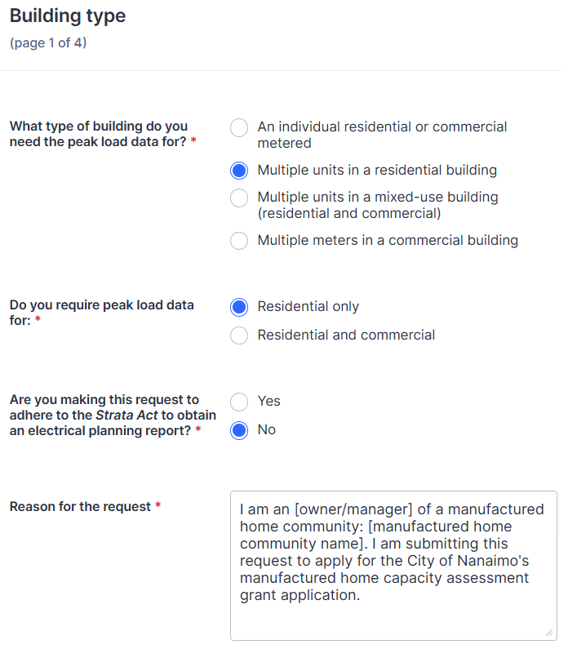
BC Hydro Data Request
The applicant must submit the data request to BC Hydro to apply for the capacity assessment grant.
You must submit the request by completing the form on this BC Hydro website (see Guidelines for link)
Please request 12 months of data.

