Slide 1
Grant Application Information Session
Building Safer Communities Fund
NANAIMO YOUTH RESILIENCE STRATEGY
Notes:
Public Safety Canada is providing funding to address community safety through the Building Safer Communities Fund (BSCF). The objective of this fund is to help municipalities and Indigenous communities prevent gun and gang violence by addressing their root cause.
The City of Nanaimo has access (through the BSCF program) to $1,156,699 to fund programs under the 6 focus areas found the Nanaimo Youth Resilience Strategy.

Slide 2
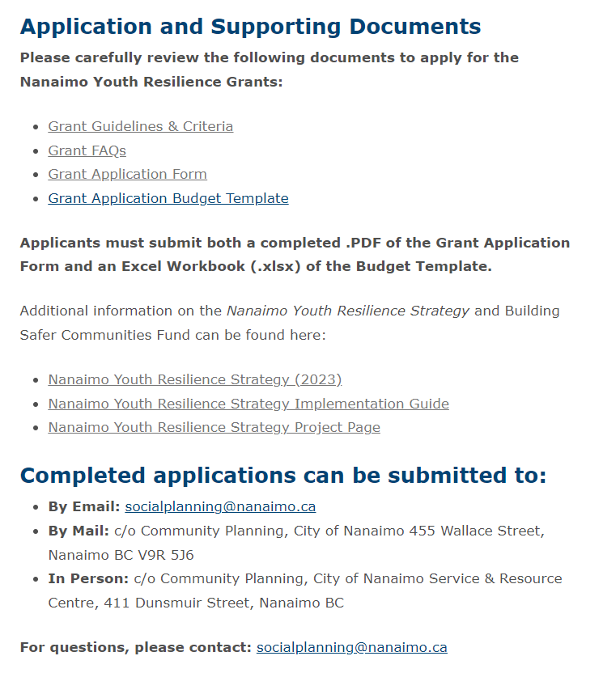
Important Supporting Documents
Nanaimo Youth Resilience Strategy (2023)
Grant Guidelines & Criteria
Grant FAQs
https://www.nanaimo.ca/your-government/grants/nanaimo-youth-resilience-grant
Notes:
Please review the Strategy, grant guidelines & criteria and FAQs all available on the City’s Grant webpage. This webpage contains all the information that will be covered here today.

Slide 3
6 Key Focus Areas
Safe Youth Gathering Spaces
To establish safe, free, youth gathering spaces, within existing facilities. The City is working to identify two locations for a safe youth gathering space. The Nanaimo Youth Resilience Grant may be used to fund programs in these spaces.
Youth Outreach
To expand street outreach and related programs including service hours and locations to build relationships with youth at risk and to meet a wide range of their needs such as food, harm reduction, engagement in recreation, access to counseling, etc.
Connecting Youth To Land And Water Through Snawaylth (Teachings)
Enhance existing and/or create new opportunities to connect youth to the land and water through Snawaylth to strengthen their mental, emotional, spiritual, and cultural resilience.
Youth Mentoring Program
To connect youth, especially youth at risk, with diverse role models and significant/caring adults (e.g. tutors, trades or vocational role models, mentors, teachers, coaches, etc.).
Enhancing Existing Programs
To improve existing programs for youth by adding new components that fill gaps and build protective factors for children and youth-at-risk (e.g. sports, culture, education, health and wellness, life skills, socio-emotional learning, volunteering etc.).
Media & Communications
To build relationships with media and develop key positive messaging to highlight successful youth programs and initiatives that counter repeated negative media attention that perpetuate discrimination and stigmatization against youth.
Notes:
The Nanaimo Youth Resilience Grant is to fund programs that support the focus areas in the NYRS. The programs must be new and/or augment existing efforts in the community that meaningfully connect with and support youth at risk (ages 11-25).

Slide 4
Risk Factors
Land & Waters Level
Limited or lack of access/availability to healthy lands & waters, including Indigenous sources of foods and medicine
Societal Level
Large number of people living in poverty
Significant prevalence of discrimination, stigmatization, and oppression, such as racism
Lack of affordable, appropriate, and safe housing
Lack of adequate services (social, physical health, mental health, addictions, etc.)
High unemployment
Community Level
Presence of organized crime & human trafficking
Repeated negative media attention
Availability of street level weapons, including firearms
Fear of social disorder (e.g. homelessness, public drug use)
Lack of adequate services (cultural, recreational)
Large number of residents reporting feeling unsafe in their neighbourhood
Neighbourhoods that show neglect and lack of sense of ownership and pride by residents
School Level
Too few teacher role models
Lack of attention to bullying (including cyberbullying)
Negative labelling by teachers
Access to street level drugs within the school
Low educational aspirations
Peer Level
Friends who are part of a gang
Friends with problematic substance use challenges
Interaction with peers in conflict with the law
Lack of meaningful peer connections
Family Level
Intimate partner and family violence
Abuse and neglect of children
Criminalized or incarcerated parents
Lone parent household with limited economic means
Notes:
The NYRS identifies risk factors that are significant for youth in Nanaimo and the recommended focus areas listed above are intended to reduce these risk factors for youth and children. Programs should work to reduce these risk factors. These can be found in the NYRS and in the Grant Guidelines and Criteria package.

Slide 5
Application Criteria
Children and youth (ages 11-25) at risk (as per risk factors)
Positive peer to peer interactions and connections
Children and youth living in poverty have access
Increases opportunities for integration of Indigenous and non-Indigenous services
Focus on anti-discrimination, anti-stigmatization, and anti-oppression (e.g., youth phobia)
Provides opportunities to connect youth to the land
Increases socio-emotional learning opportunities
Offers services during peak hours for youth activity
Connects youth to diverse role models or significant/caring adults
Trauma-informed practices and cultural awareness
Works to remove barriers to access (transportation, costs, etc.)
Focuses on culture, healthy relationships, and pro-social activities
Includes supports for family members of youth participants
Wraparound approaches
Recruitment and referral process
Community Partnerships
Notes:
In addition, the NYRS lists further criteria to ensure that programs are low barrier, accessible, and equitable. The following criteria were developed to guide the funding distribution. A program should meet most of the criteria listed here to be selected for funding. Again these are found in the NYRS and the Grant and Guidelines Criteria.

Slide 6
Who can apply for this funding?
Established non-profit organizations, public sector entities or government bodies
Organizations located outside of the City of Nanaimo or Snuneymuxw First Nation reserve lands can apply, however, funds must be only used for programs delivered within the boundaries of the City of Nanaimo and Snuneymuxw First Nation

Slide 7
Application Timeline
Applications must be submitted by 12 pm Monday, August 14, 2023
Programs must start during the Fall/Winter of 2023, and can be funded until March 2026
Applications received after this date will only be considered if there are unused funds. Late requests may be considered in exceptional or unforeseen circumstances
Successful applicants will receive written notification of Council’s decision by the end of September 2023
Notes:
July 10, 2023: Applications open.
July 12, 2023: Online information session.
August 14, 2023: Applications close at 12 pm
September 13, 2023: Recommendations from the NYRS Steering Committee for fund distribution will be presented at the City of Nanaimo Finance and Audit Committee meeting.
September 25, 2023: Official endorsement of Finance and Audit Committee recommendations at City of Nanaimo Council Meeting.
September 26 to September 29: Finalize all agreements with successful applicants.
October 1: Provide access to funds to successful applicants.

Slide 8
Application
Notes:
Complete applications include the grant application form and the grant application budgets
Can be accessed online or can be provided a paper copy.
Submit completed application packages by 12:00 pm on Monday, August 14, 2023. •
By Email: socialplanning@nanaimo.ca •
By Mail: c/o Community Planning, City of Nanaimo 455 Wallace Street, Nanaimo BC V9R 5J6 •
In Person: c/o Community Planning, City of Nanaimo Service & Resource Centre, 411 Dunsmuir Street, Nanaimo BC

Slide 9
Program Budgets
Funding Timeline
Year 1: October 1, 2023, to March 31, 2024
Year 2: April 1, 2024, to March 31, 2025
Year 3: April 1, 2025, to March 31, 2026
Notes:
Depending on the duration of your proposed program you will need to supply a budget for each fiscal year you plan to provide programming. This is to align with the distribution of funds being provided to the City by PSC.

Slide 10
Program Budgets
Funding Distribution
 | Focus Area | Steering Committee Rating ‘Impact – Effort’ | Proposed % of BSC Program Funds
1. | Safe Youth Gathering Spaces | High Impact – High Effort | 30%
2. | Youth Outreach | High Impact – High Effort | 25%
3. | Connecting Youth to Land and Water Through Snawaylth | High Impact – Medium Effort | 15%
4. | Youth Mentoring Program | High Impact – Medium Effort | 10%
5. | Enhancing Existing Programs | High Impact – High Effort | 15%
6. | Media & Communications | High Impact – Low Effort | 5%
Notes:
The funding distribution is further guided by the Steering Committee by identifying the impact and effort rating for each time of program. This is based on experience and knowledge of delivering similar types of programs. These are estimates and will vary depending on the actual grant applications received.

Slide 11
Program Budgets
BSCF Funding Distribution:
Year 1: $441,375
Year 2: $438,760
Year 3: $231,563
Notes:
Further breakdown of funds based on estimated % for each focus area for each year will be added to the program budget template. Just a reminder that these are estimates and may vary depending on the grant applications received.

Slide 12
Eligible Expenses
Salaries, wages and benefits for temporary professional, clerical, technical and administrative services, and stipends (including expenses for international staff);
Professional and consultant costs, not limited to audit and evaluation expenses and professional fees related to the preparation of financial statements
Recruitment and Training Costs (e.g. courses, workshops, etc.);
Costs associated to conferences, including conference room, virtual conferences and associated equipment rentals
Reasonable Travel, accommodations and related expenses in accordance with National Joint Council Guidelines as well as bus tickets, tokens, and other reasonable participant related transportation reimbursements;
Rent, normal utilities such as electricity, heat, water and telephone, and maintenance of offices and other buildings where the expenses are directly related to the development and implementation of the project
Office equipment, supplies and materials, including computers, printers/scanners, and communications equipment and associated costs
Notes:
Eligible expenses are listed in the budget template and must not be changed. This is to align with PSC eligible expenses outlined in the BSCF.

Slide 13
Eligible Expenses
Minor renovations to the facility where the interventions are taking place (principally required to enhance security or to ensure program fidelity), where deemed essential for the success of the project. Minor renovations are defined as $10,000 in total or less, over the course of the project
Translation and simultaneous interpretation costs;
Meals and/or refreshments for participants in activities and workshops directly related to the project
Honoraria, defined as time-limited remuneration for a volunteer service or participation in project delivery that is consistent with, and essential to the attainment of, the project’s objectives. This can include, but is not limited to, volunteer services and guest speakers; but cannot be provided for individuals whose participation in a project is already being compensated (e.g., by their employer) or is being accrued as part of an in-kind contribution
Culturally appropriate expenditures including gifts (for a maximum of $100), community feasts, ceremonies and ceremonial meals, gatherings, and circles in accordance with National Joint Council guidelines

Slide 14
Ineligible Expenses
Goods and services that are normally provided by the service agency
Cannot be used to pay for regular or ongoing police services
Core or ongoing operating expenses
Hospitality, that does not meet the eligible expenses criteria
Interest charges or costs of borrowing; and
Amortization

Slide 15
Grant Application Evaluation Process
Applications will be received and reviewed by an Evaluation Committee comprised of NYRS Steering Committee members, City of Nanaimo and Snuneymuxw Staff
Recommendations for fund distribution will be forwarded to the City of Nanaimo Council for consideration of approval
Successful applicants will receive written notice of Council’s decision by the end of September 2023
Notes:
Evaluation Committee members are comprised of SC members not applying for funding, City of Nanaimo and Snuneymuxw First Nation Staff.

Slide 16
Grant Application Evaluation Process
Applications will be evaluated by the criteria listed in the NYRS Grant Guidelines and will be weighted by the following questions:
Relevance (25%) – Does the program reflect the focus areas in the NYRS and work to address the identified risk factors?
Accessible and Equitable (25%) – Does the program incorporate most of the criteria identified to ensure that children and youth at risk can access programming?
Impact (20%) – What difference will the program make for the intended audience?
Efficiency (10%) – How well are resources utilized.
Sustainability (10%) – Will the benefits for the programs last beyond the funding cycle?

Slide 17
Funding for Existing Programs
Funding can be used to add notable enhancements to existing programs.
Existing programs could be enhanced by adding some of the following elements:
Sports and recreation;
Connecting urban Indigenous youth to culture, Elders and the land;
Educational, health and wellness programming;
Youth mentorship;
Life skills and socio-emotional learning;
Inclusion of family members of youth in provision of food, treatment and other services;
Food security measures, including gardening, to connect with the land and Indigenous culture;
Opportunities for youth to foster a sense of belonging, value, and connectedness with the community through reciprocity through volunteering.
Notes:
This funding cannot be used to fund existing programs however it can be funded to add notable enhancements to existing programs that that help to reduce risk factors identified in the NYRS.

Slide 18
Reporting Requirements
All applicants who receive Nanaimo Youth Resilience Grant funding must comply with the reporting timelines as set out by Public Safety Canada and the City of Nanaimo. Failure to meet reporting timelines may result in the rejection of new applications or the delay in releasing further funding.
This will include but is not limited to:
Program activity summaries;
Quantitative and qualitative data on program indicators and measures;
Separate NYR general ledger reporting including the appropriate back up receipts;
and other information as requested by the City of Nanaimo.
These details will be outlined in service agreements between organizations and the City of Nanaimo.

Slide 19
Questions?

