Slide 1

Manufactured Home Community Redevelopment Policy - Engagement
City of Nanaimo
June 18, 2025

Slide 2
Outline
About Us
Project and Presentation Purpose
Current Protections and Requirements
Overview of Land Economics / Financial Analysis
Next Steps
Questions

Slide 3
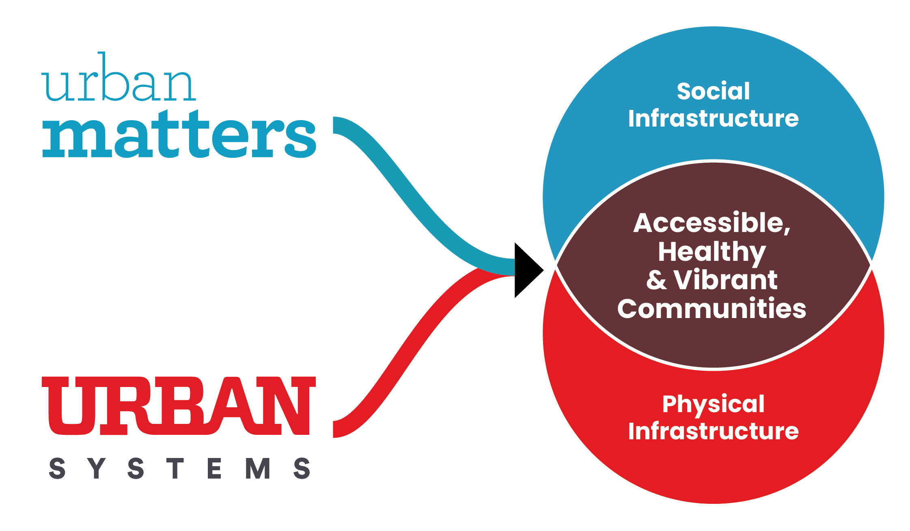
About Us
Urban Matters has been retained by the City of Nanaimo to provide a financial feasibility analysis to inform the City’s review of the Zoning Bylaw and exploration of inclusionary zoning, density bonusing, and tenant protection policies
Project Team:
Matt Thomson
Will Volpe
Jodee Ng
Justin Barer

Slide 4
Project and Presentation Purpose
Project Purpose: Help the City understand the financial capacity and implications of utilizing inclusionary zoning, density bonusing, and tenant relocation protections on a range of development types to ultimately inform the development of a new Zoning Bylaw and Tenant Protection Policies
Presentation Purpose: To meet with the manufactured home community residents’ stakeholder group in Nanaimo and provide information on how compensation may be calculated from a developer’s perspective

Slide 5
Policy considerations

Slide 6
Current Protections
Under the current Manufactured Home Park Tenancy Act, when a developer ends a manufactured home site tenancy to redevelop the site, they must at minimum provide the following:
  A minimum of 12 months’ written notice after they have obtained all necessary permits and approvals
  Compensation of at least $20,000
    If the home can't be moved and its assessed value is over $20,000, the tenant is owed the value minus $20,000
    Manufactured home park residents have the right to dispute the notice by applying for dispute resolution within 15 days of receiving a 12-month notice.
    We recognize that these protections are not automatically provided. There may be several challenges that make them difficult to access.

Slide 7
Going Beyond These Requirements
Other communities in BC have Manufactured Home Park Redevelopment Policy, that include additional protections beyond the minimum requirements of the Province. They include:
  City of Surrey
  City of Coquitlam
  City of Kelowna
  City of Revelstoke
  City of Mission
  As part of our work, we are considering what other communities are requiring from developers, such as a right of first refusal, relocation assistance, and other forms of notification, etc.

Slide 8
What We’ve Heard
Some members of this committee are looking for protections beyond what is required by the Province, including:
  Market value of the manufactured home
  Moving costs
  Relocation assistance
The committee has said they want more clarity about what protections will be available if a manufactured home community is redeveloped.
Some have also shared that having the option to choose the protections that best fit their needs would be helpful, such as receiving compensation instead of moving support.

Slide 9
Land Development Economics
The ability for a developer to pay compensation during the redevelopment of a manufactured home community is a function of site conditions and market dynamics
If the costs to redevelop are too high, then the site may not redevelop. The City is currently reviewing fees and charges to pay for community infrastructure and amenities, including:
  Development Cost Charges (DCCs)
  Amenity Cost Charges (ACCs)
  Exploring inclusionary zoning (affordable housing)
DEVELOPMENT VIABILITY

Slide 10
Why Do We Care About Viability?
As part of the Housing Supply Act, the B.C. government has identified Nanaimo as one of the priority municipalities to meet housing targets. The Province wants to see communities supporting housing supply that addresses their housing needs, and to ensure that policies and process do not inhibit appropriate housing development unnecessarily.
By designing good policy, we can ensure development balances the need for new housing supply with the needs of the existing residents.

Slide 11
Land Development Economics
Land Use Policy and Plans
Market Conditions (Costs, Revenues)
Availability and Value of Land
Available Capital and Financing
Some factors that influence the compensation provided are:
  Highest and best use of the site
  Owner expectations of land sale value
  Development costs and achievable sales
  Competing opportunities for financial investment
DEVELOPMENT VIABILITY

Slide 12
Land Development Economics
“Sweet Spot”
Compensation is a development cost
If the ‘stack of costs’ become higher than the achievable revenues, then there is no money to be made on the redevelopment project
Finding the “sweet spot” is the goal of the analysis, where the compensation level will not deter redevelopment

Slide 13
Next Steps
Undertaking financial analysis to understand what the ‘sweet spot’ for development viability is
Testing (on modular home community redevelopments) will start with at least 2 key scenarios:
  Minimum requirements by the province
  Identified asks from MHC Stakeholder Group
  Depending on outcomes, may also test a scenario that is somewhere between these two
The analysis will inform the policy that the City develops

Slide 14
Questions?

